Slide 1
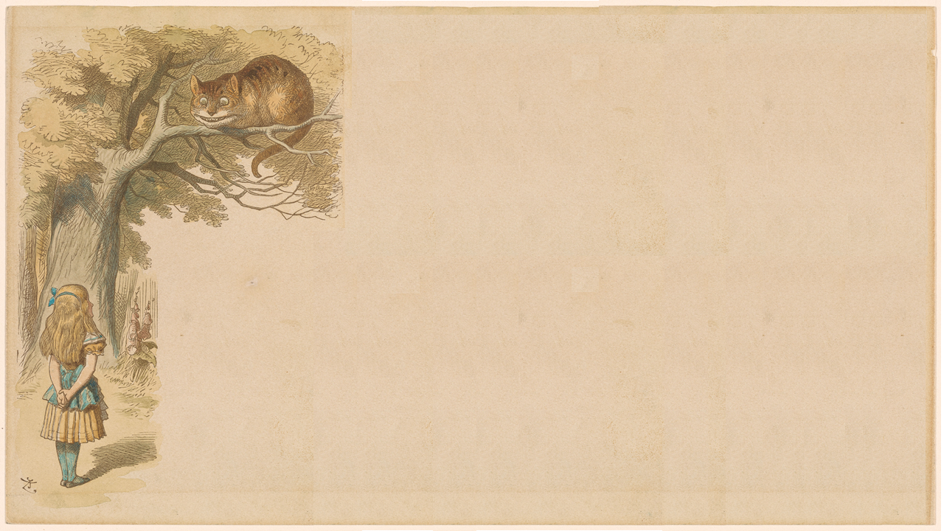
Do Androids Dream?
Creative Tech Week 2016
Arts Hub - New York
Panel May 5, 2016 4:45 – 5:30 PM
github.com/Androids-dream
Notes:
Cre

Slide 2
Welcome
Motivating question is "What can we learn about visual art and human imagination from deep neural networks"
Our panelists:
Gizem Küçükoğlu: vision researcher at NYU will summarize brain models of visual perception/cognition.
Dr. Matt Zeiler: founder of the AI Vision company Clarifai.
Matt’s deep neural network visualization techniques drove major breakthroughs in object recognition accuracy, winning for Clarifai the top five places in the 2013 ImageNet competition (beating entries from top AI research centers like Google, Microsoft, etc.
Dr. Nick Lambert, Art and culture historian and a major figure in CTW 2016.
Cassidy Williams – Developer Evangelist at Clarifai

Slide 3
Machine Vision History
Classic: Human specified visual features
Robots picking up well-defined objects in factory environment
Hand-crafted convolutional filters to detect faces in an image
Since 1980’s: Discovering features via Neural Nets
Object Detection & Classification
Visualizing Discovered Features

Slide 4
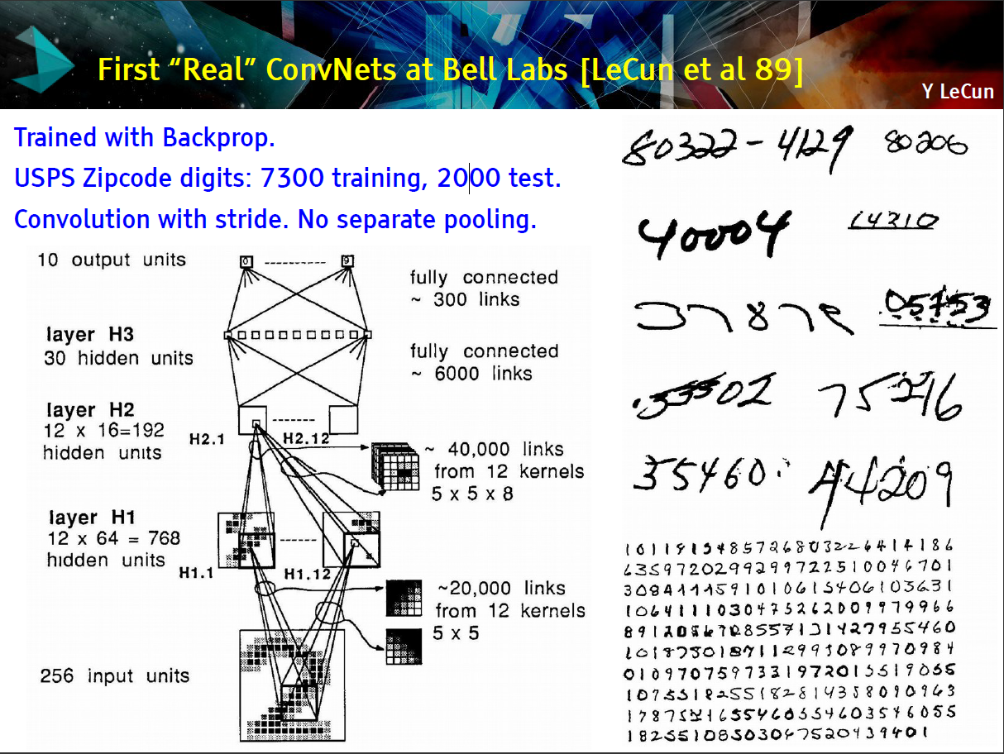

Slide 5
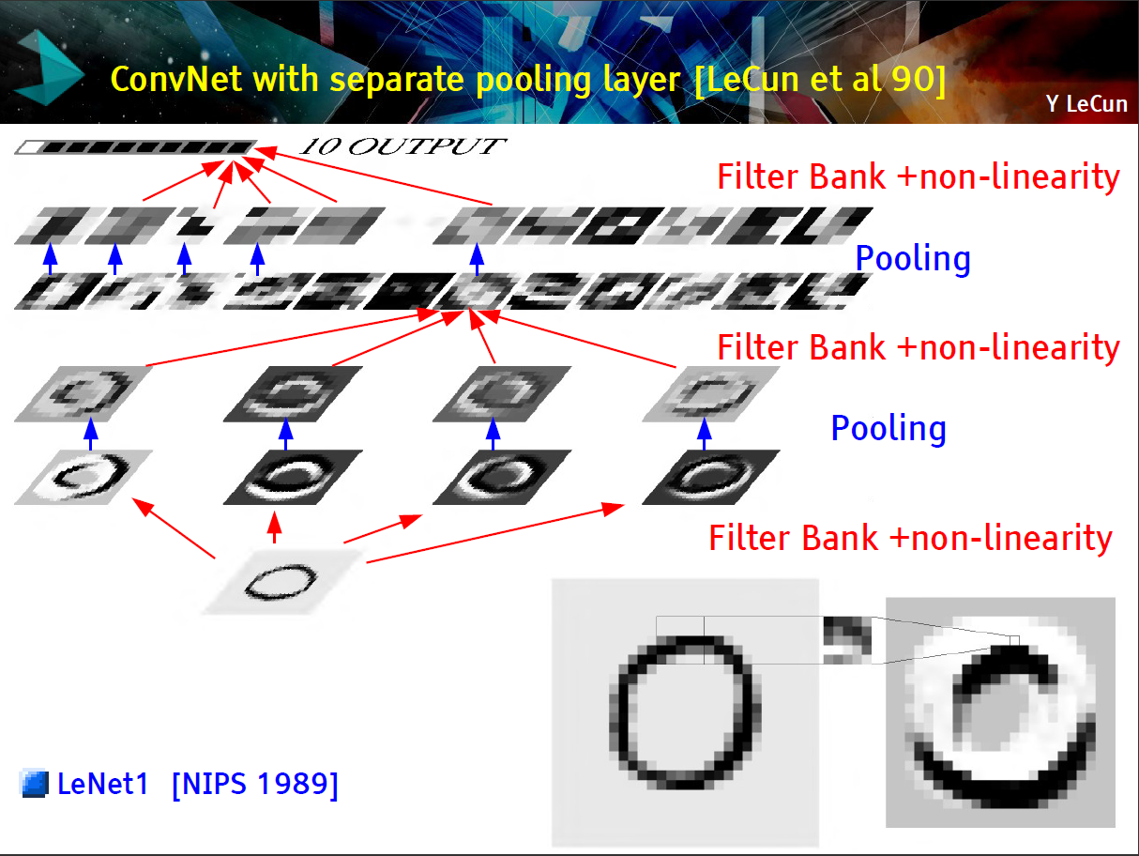
Convolution 1st Layer like Photoshop Edge filters
Input scanned Image

Slide 6
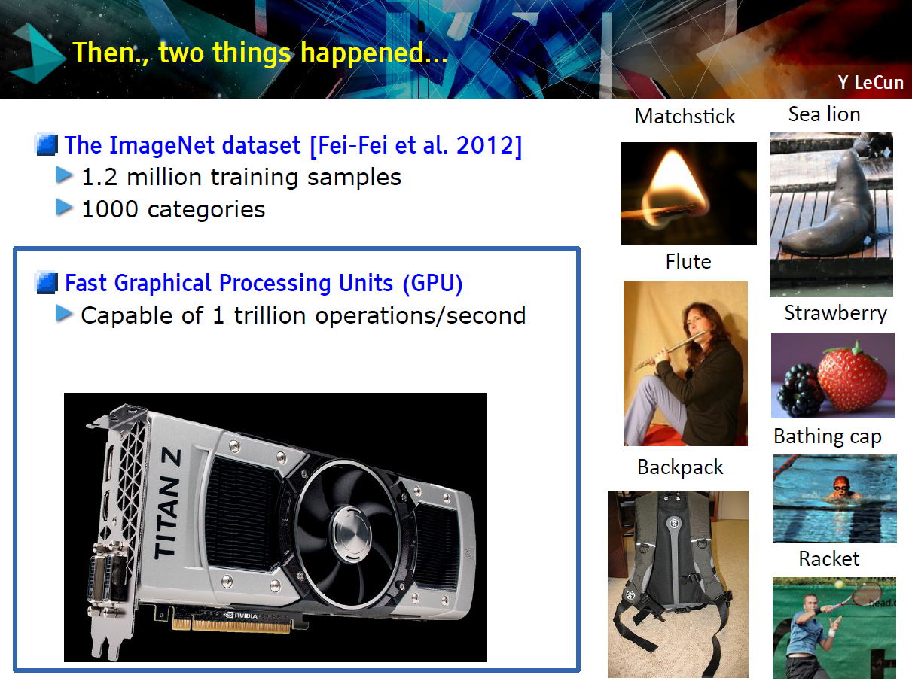

Slide 7
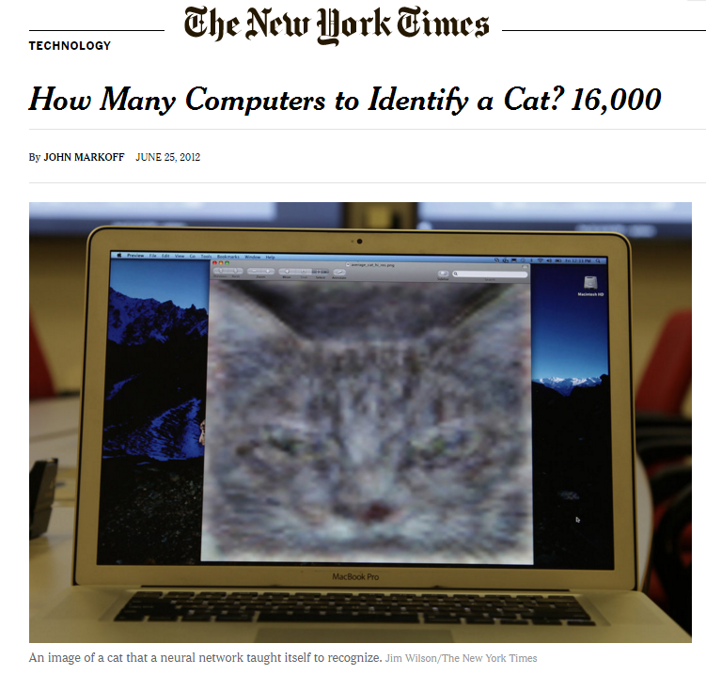
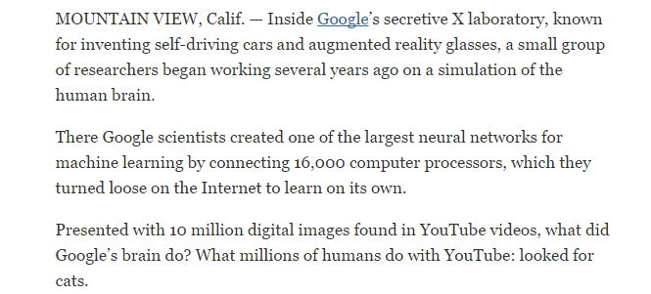
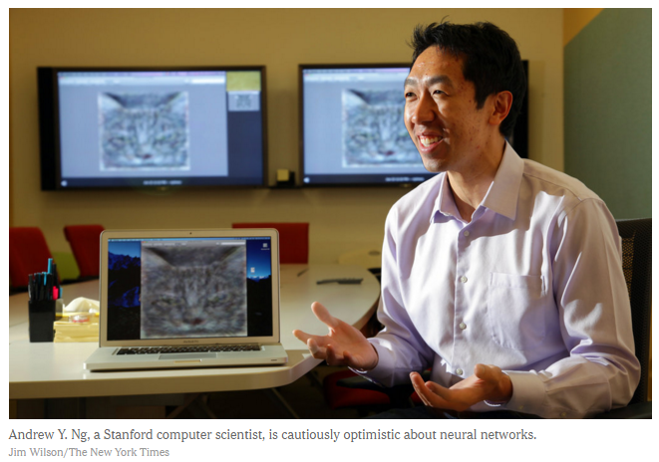
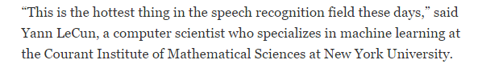
NY Times - Unsupervised Learning – June 25, 2012

Slide 8
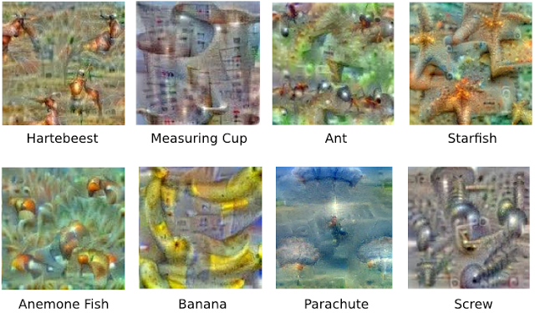
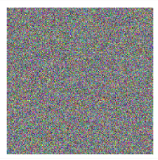
optimize with prior
Google Research Blog
Inceptionism: Going Deeper into Neural Networks, June 17, 2015

Slide 9


optimize with prior
Dumbbells
There are dumbbells in there alright, but it seems no picture of a dumbbell is complete without a muscular weightlifter there to lift them.
Google Research Blog
Inceptionism: Going Deeper into Neural Networks, June 17, 2015

Slide 10
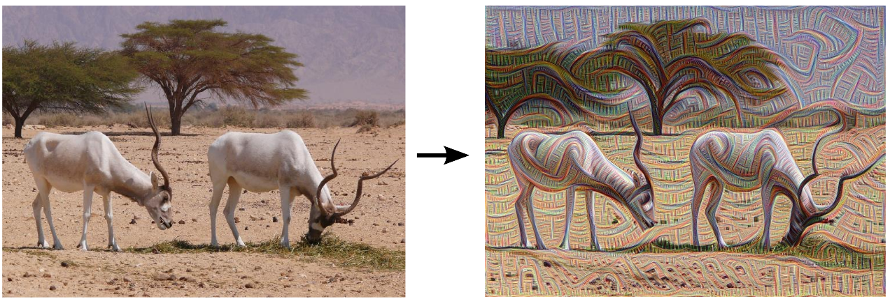
Google Research Blog
Inceptionism: Going Deeper into Neural Networks, June 17, 2015

Slide 11
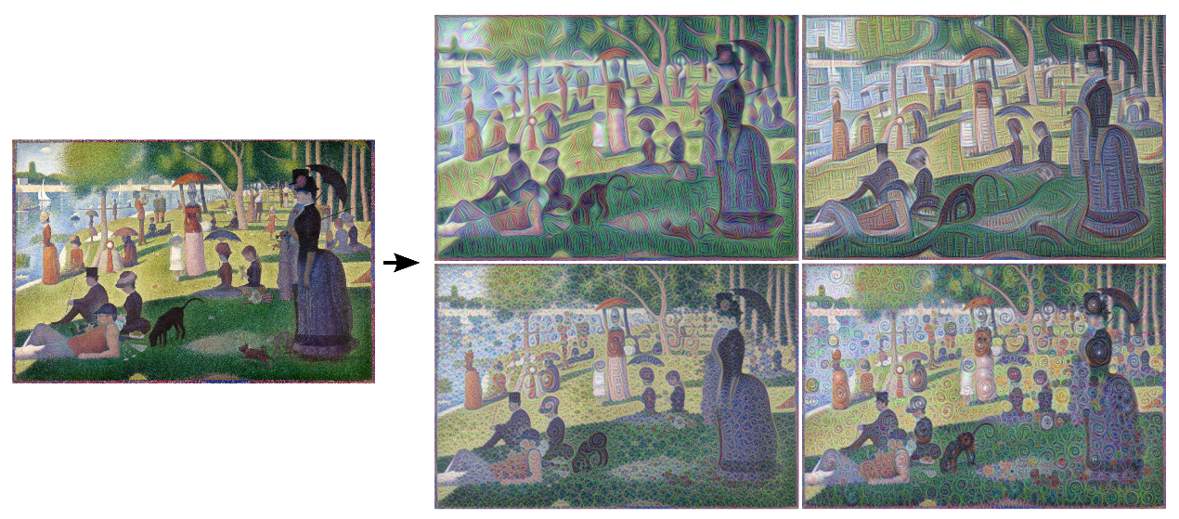
Google Research Blog
Inceptionism: Going Deeper into Neural Networks, June 17, 2015

Slide 12
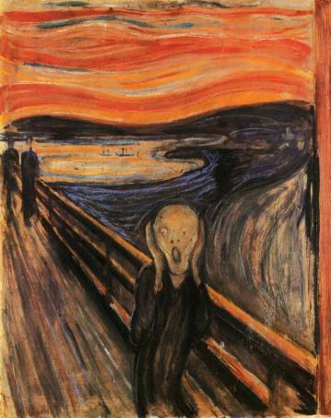
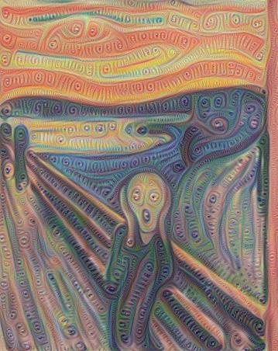

Google Research Blog
Inceptionism: Going Deeper into Neural Networks, June 17, 2015

Slide 13
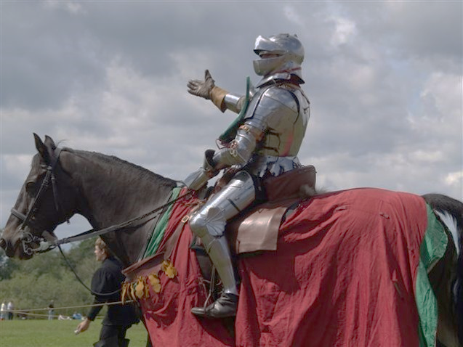
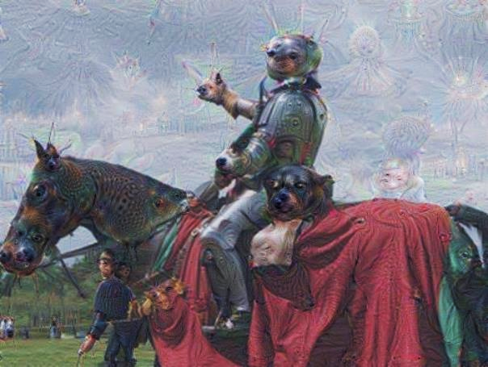
Google Research Blog
Inceptionism: Going Deeper into Neural Networks, June 17, 2015

Slide 14

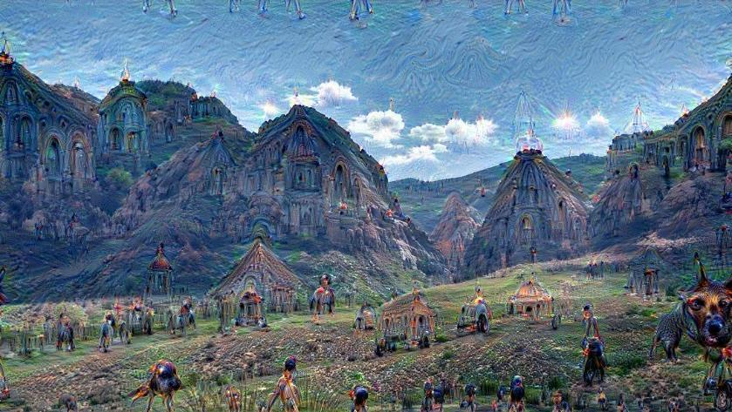
Google Research Blog
Inceptionism: Going Deeper into Neural Networks, June 17, 2015

Slide 15

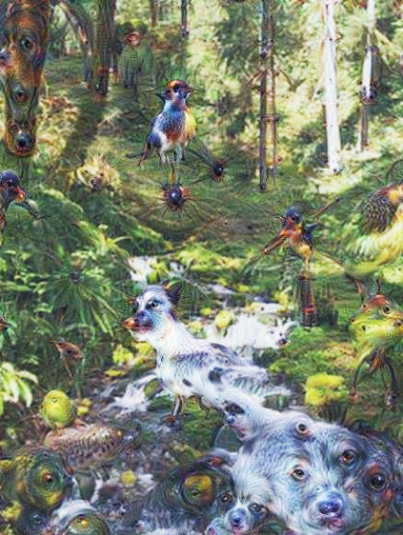
Google Research Blog
Inceptionism: Going Deeper into Neural Networks, June 17, 2015

Slide 16
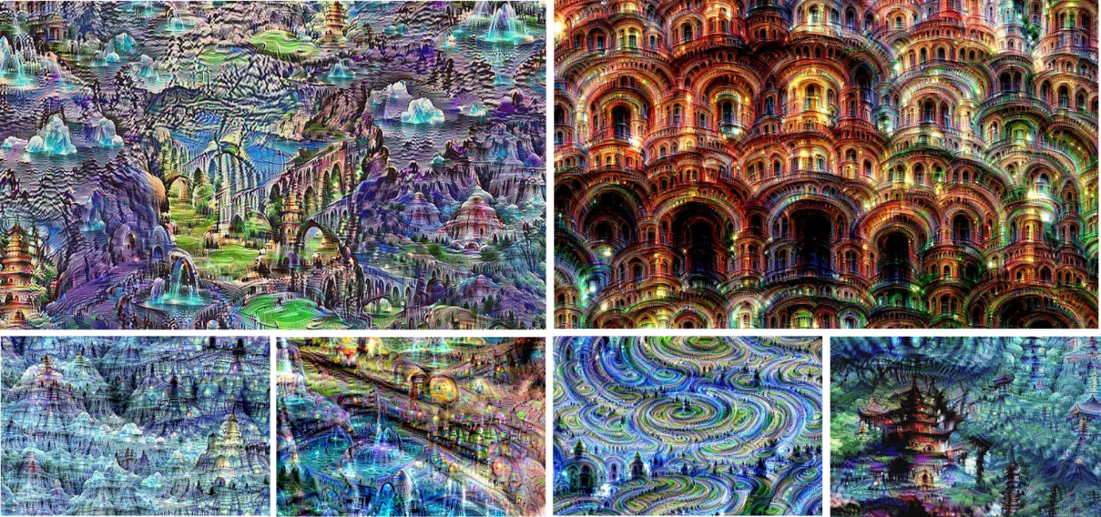
Google Research Blog
Inceptionism: Going Deeper into Neural Networks, June 17, 2015

Slide 17
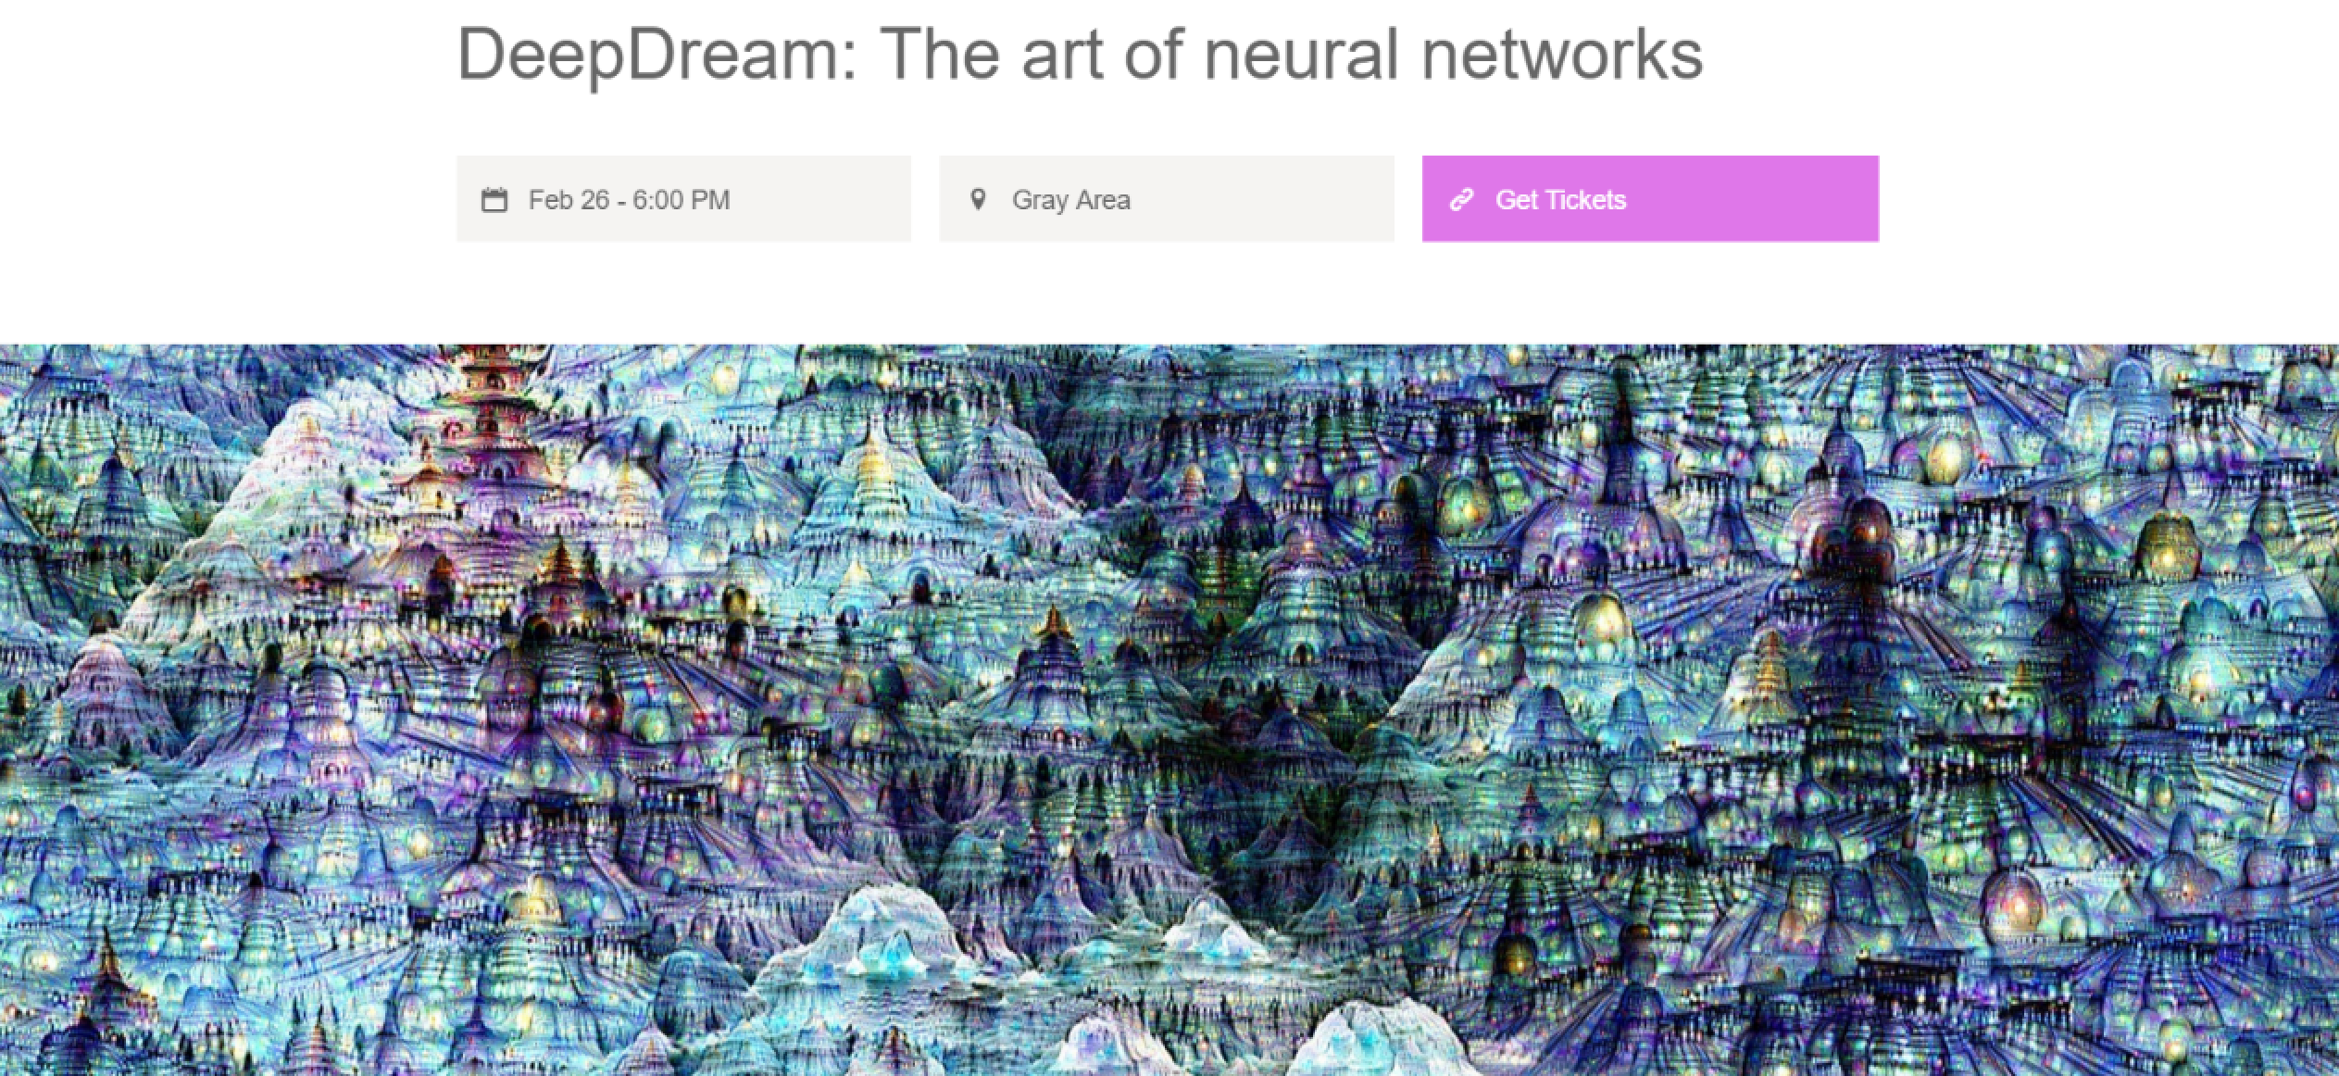

Slide 18
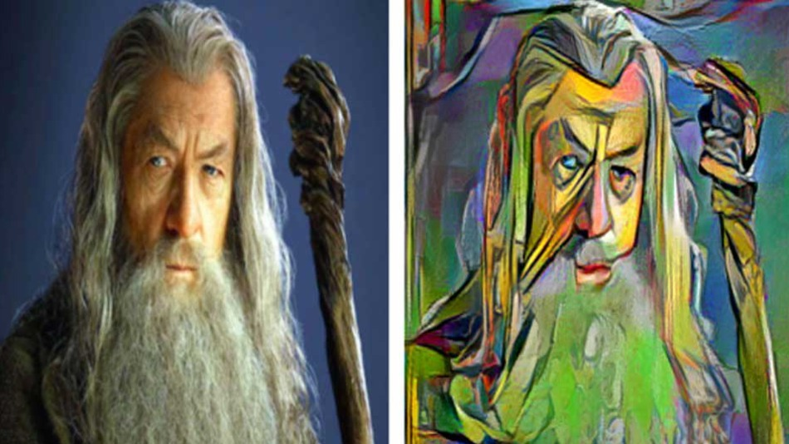

Slide 19
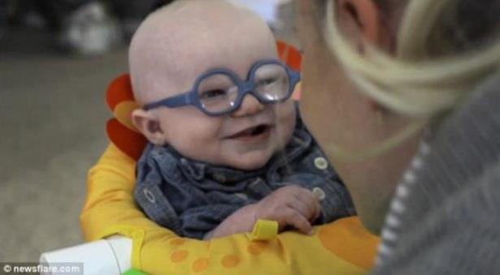
Do CNNs give us insights to human vision?
Analogies to Biological Vision?
Pros: Primate Vision – 30 layers
Cons: Perceived objects exist in space, time, and causal framework with respect to perceiver.
Vision evolving 500+ million years: Innate Abilities?
Newborn chicks see hawk’s shadow
Baby recognizes smile

Slide 20
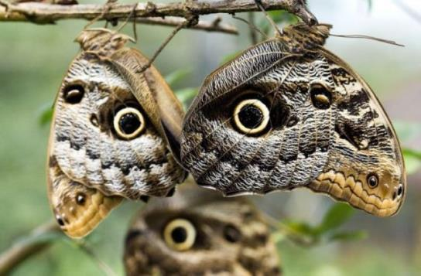
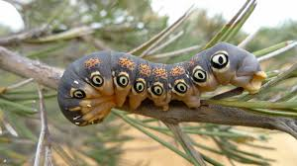
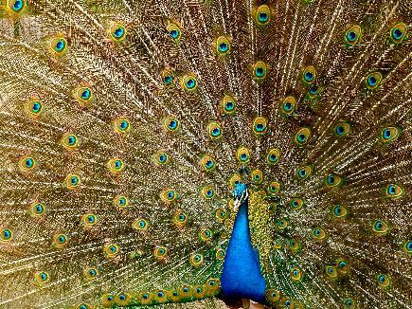
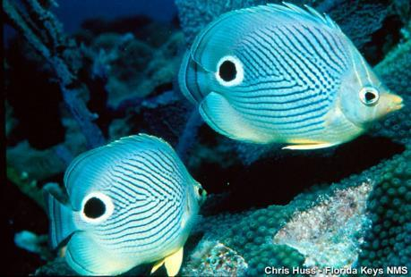
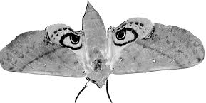
The Eyes Have It !!

Slide 21


Zero Trial Learning?

Slide 22
Invitation to Continue this Inquiry
Deep dive into techniques and tools
Deep Dream via Caffe and TensorFlow
Clarifai Developer Tools
Ongoing
Define a program of inquiry
Invite additional experts in various disciplines
Develop an on-line forum
Ongoing series of events (in conjunction with meetups like Brains ‘n Bots, NYC Deep Learning, Etc.)

